Slide 1
CSE 423: Embedded Systems
Lecture: 2
Intro to the Arduino
Topics:
The Arduino
Digital IO
Analog IO
Serial Communication
Notes:
23/10/2016
CSE423@DiU, Summer'2017

Slide 2
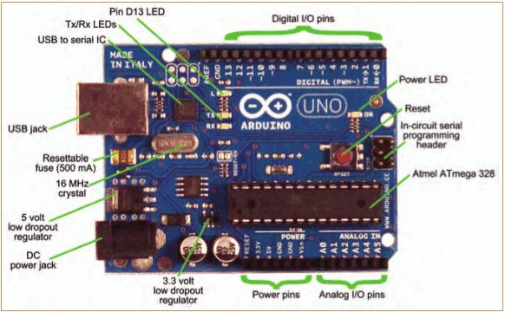
Topic 1: Meet Arduino Uno
CSE423@DIU, Summer 2019
Notes:
23/10/2016
CSE423@DiU, Summer'2017

Slide 3
Virtual Simulator
https://circuits.io/lab
CSE423@DIU, Summer 2019
Notes:
23/10/2016
CSE423@DiU, Summer'2017

Slide 4
Getting Started
Check out: http://arduino.cc/en/Guide/HomePage
  Download & install the Arduino environment (IDE) (not needed in lab)
  Connect the board to your computer via the USB cable
  If needed, install the drivers (not needed in lab)
  Launch the Arduino IDE
  Select your board
  Select your serial port
  Open the blink example
  Upload the program
CSE423@DIU, Summer 2019

Slide 5
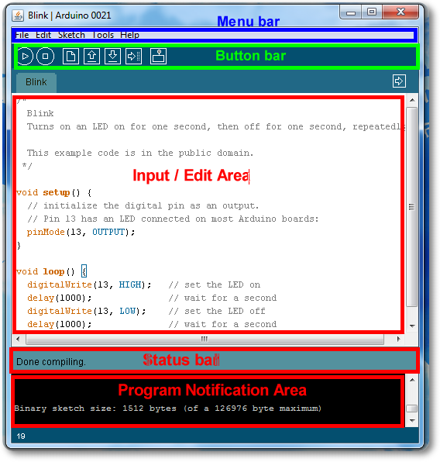
Arduino IDE
CSE423@DIU, Summer 2019

Slide 6
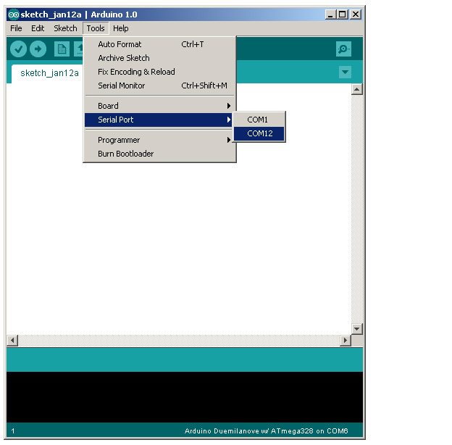
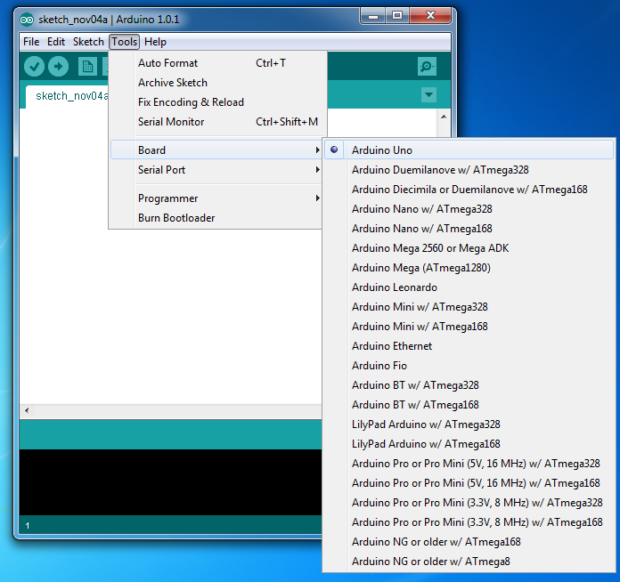
Select Serial Port and Board
CSE423@DIU, Summer 2019

Slide 7
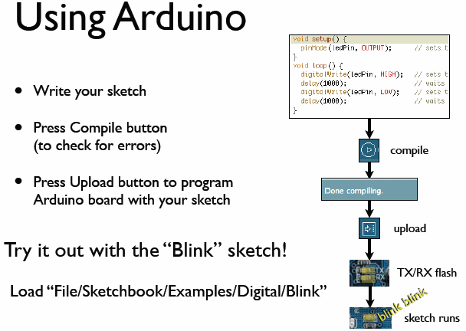
todbot.com/blog/bionicarduino
CSE423@DIU, Summer 2019

Slide 8
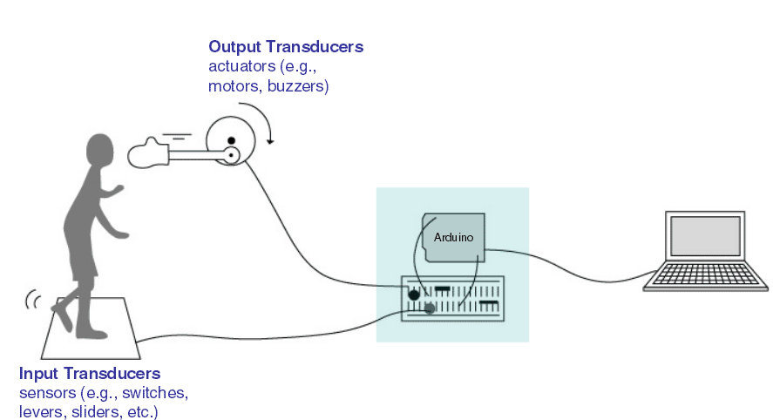
Input/Output
Image from Theory and Practice of Tangible User Interfaces at UC Berkley
CSE423@DIU, Summer 2019

Slide 9
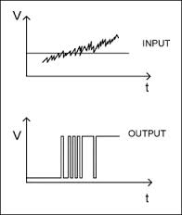
Topic 2: Digital Input/Output
1
Digital IO is binary valued—it’s either on or off, 1 or 0
Internally, all microprocessors are digital, why?
0
CSE423@DIU, Summer 2019

Slide 10
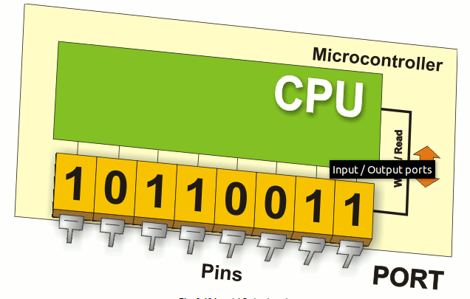
Arduino Digital I/0
www.mikroe.com/chapters/view/1
pinMode(pin, mode)
  Sets pin to either INPUT or OUTPUT
digitalRead(pin)
  Reads HIGH or LOW from a pin
digitalWrite(pin, value)
  Writes HIGH or LOW to a pin
Electronic stuff
  Output pins can provide 40 mA of current
  Writing HIGH to an input pin installs a 20KΩ pullup
CSE423@DIU, Summer 2019
Notes:
23/10/2016
CSE423@DiU, Summer'2017

Slide 11
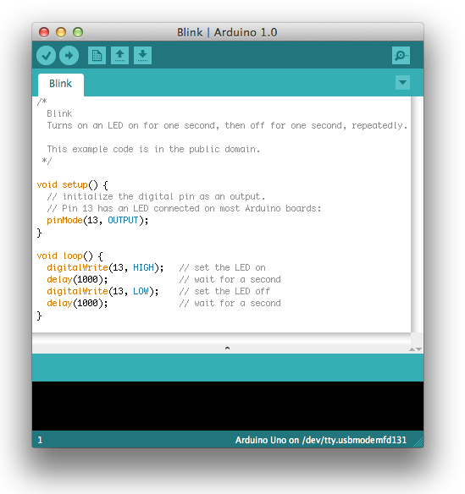
Our First Program
CSE423@DIU, Summer 2019

Slide 12
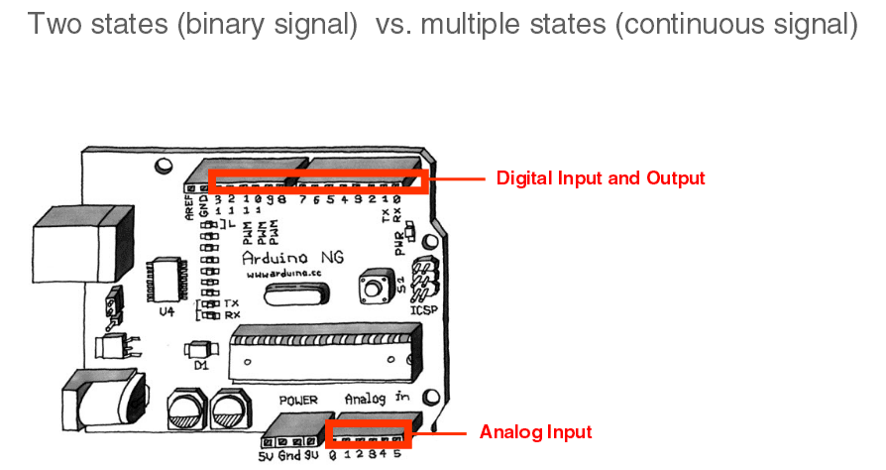
IO Pins
Image from Theory and Practice of Tangible User Interfaces at UC Berkley
CSE423@DIU, Summer 2019

Slide 13
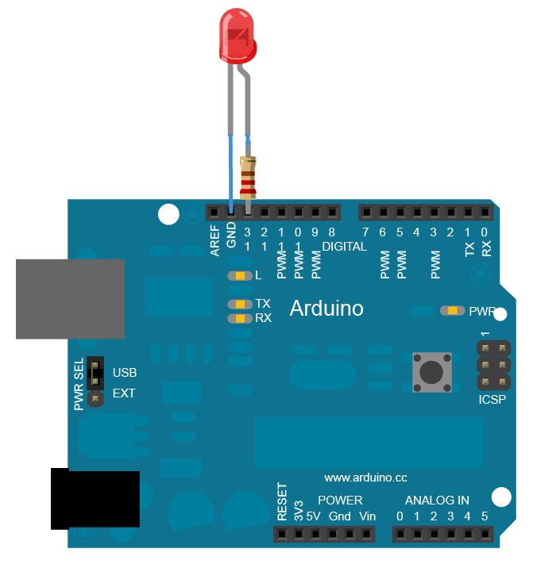
In-class Exercise 1: Digital I/O
CSE423@DIU, Summer 2019

Slide 14
Sketch for OUTPUT (Turn on LED)
int LED=13,
void setup()
{
pinMode(LED, OUTPUT);
}
void loop()
{
digitalWrite(LED, HIGH);
}
CSE423@DIU, Summer 2019

Slide 15
Sketch for OUTPUT (Turn on LED)
int LED=13,
void setup()
{
pinMode(LED, OUTPUT);
}
void loop()
{
digitalWrite(LED, HIGH);
delay(1000);
digitalWrite(LED, LOW);
delay(1000);
}
CSE423@DIU, Summer 2019

Slide 16
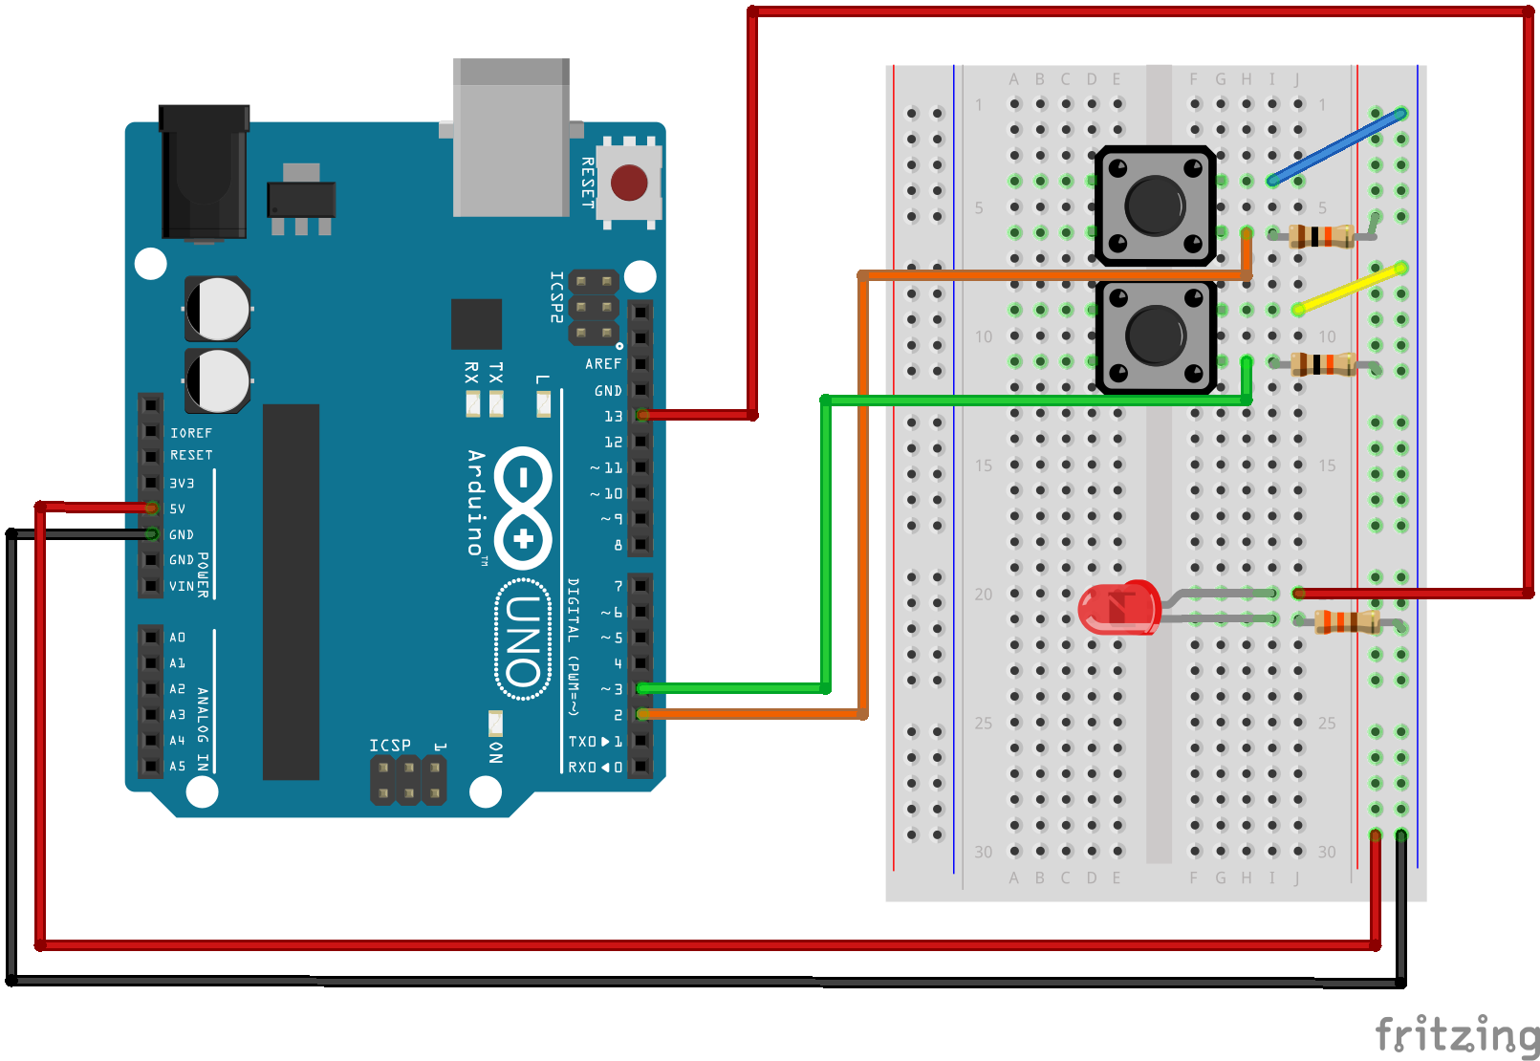
Circuit Diagram (INPUT)
CSE423@DIU, Summer 2019

Slide 17
Sketch for Input
int val = 0;
void setup()
{
pinMode(13, OUTPUT);
pinMode(7, INPUT);
}
void loop()
{
val = digitalRead(7);
if (val == HIGH) {
digitalWrite(13, LOW);
} else
{
digitalWrite(13, HIGH);
}
}
CSE423@DIU, Summer 2019

Slide 18
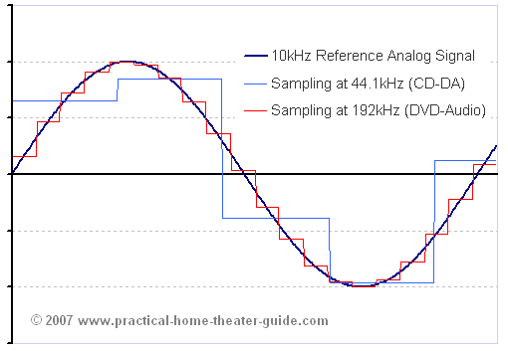
Topic 3: Analog Input
Think about music stored on a CD---an analog signal captured on digital media
  Sample rate
  Word length
CSE423@DIU, Summer 2019

Slide 19
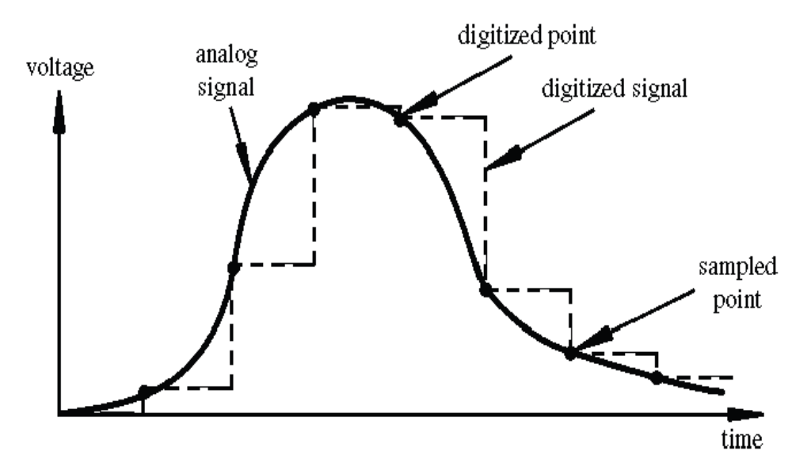
Arduino Analog Input
Image credit: Tod Kurt
Resolution: the number of different voltage levels (i.e., states) used to discretize an input signal
Resolution values range from 256 states (8 bits) to 4,294,967,296 states (32 bits)
The Arduino uses 1024 states (10 bits)
Smallest measurable voltage change is 5V/1024 or 4.8 mV
Maximum sample rate is 10,000 times a second
CSE423@DIU, Summer 2019
Notes:
23/10/2016
CSE423@DiU, Summer'2017

Slide 20
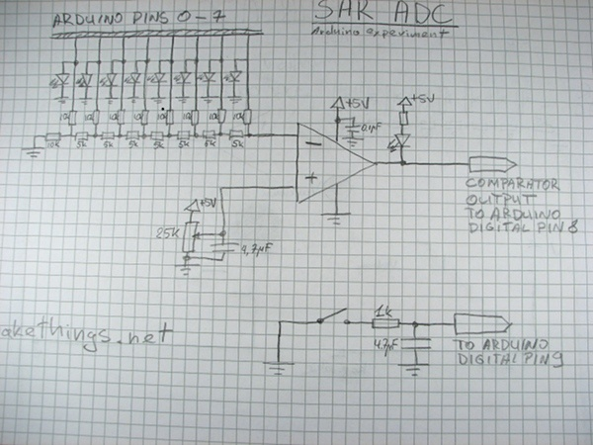
How does ADC work?
How does ADC work
Excel Demonstration
CSE423@DIU, Summer 2019

Slide 21
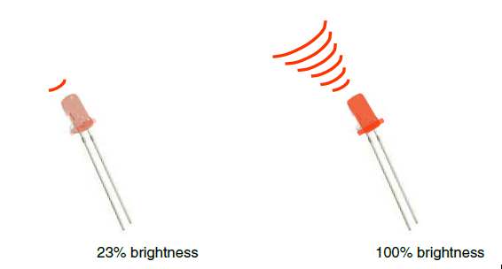
Topic 3: Analog Output
Can a digital device produce analog output?
Image from Theory and Practice of Tangible User Interfaces at UC Berkley
Analog output can be simulated using pulse width modulation (PWM)
CSE423@DIU, Summer 2019

Slide 22
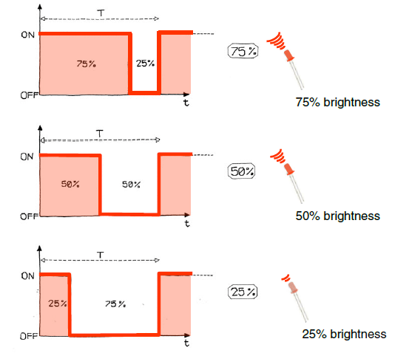
Pulse Width Modulation
Can’t use digital pins to directly supply say 2.5V, but can pulse the output on and off really fast to produce the same effect
The on-off pulsing happens so quickly, the connected output device “sees” the result as a reduction in the voltage
Image from Theory and Practice of Tangible User Interfaces at UC Berkley
CSE423@DIU, Summer 2019

Slide 23
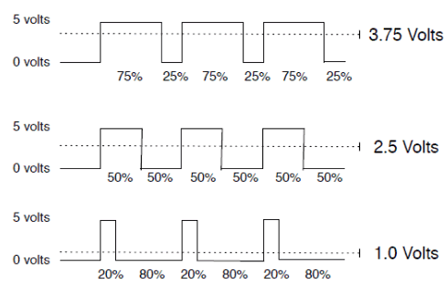
PWM Duty Cycle
output voltage = (on_time / cycle_time) * 5V
Image credit: Tod Kurt
Fixed cycle length; constant number of cycles/sec
CSE423@DIU, Summer 2019

Slide 24
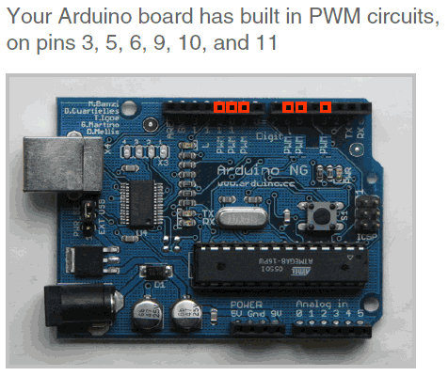
PMW Pins
Command: analogWrite(pin,value)
value is duty cycle: between 0 and 255
Examples:
analogWrite(9, 128)
for a 50% duty cycle
analogWrite(11, 64)
for a 25% duty cycle
Image from Theory and Practice of Tangible User Interfaces at UC Berkley
CSE423@DIU, Summer 2019

Slide 25
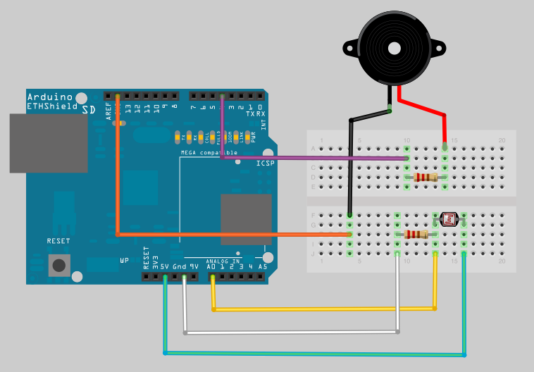
In-class Exercise 2: Analog IO
Part 1:
A light theremin
CSE423@DIU, Summer 2019

Slide 26
In-class Exercise 2: Analog IO
Part 2: Add an LED
Add a 330 ohm resistor and an LED to pin 9
Using the analogWrite() command, set the intensity of the LED as a function of the value of prReading
CSE423@DIU, Summer 2019

Slide 27
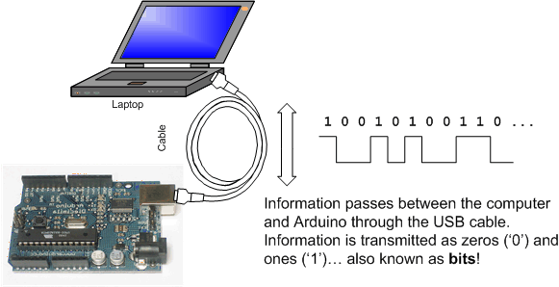
Topic 4: Serial Communication
CSE423@DIU, Summer 2019

Slide 28
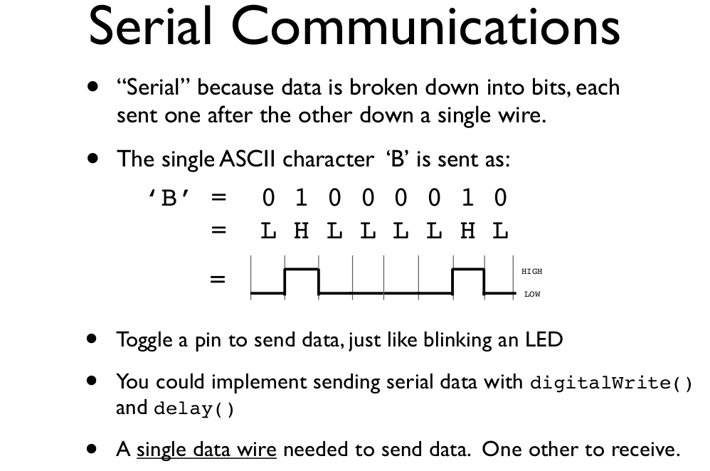
CSE423@DIU, Summer 2019
Notes:
23/10/2016
CSE423@DiU, Summer'2017

Slide 29
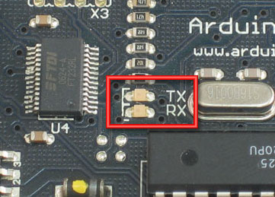
Serial Communication
Compiling turns your program into binary data (ones and zeros)
Uploading sends the bits through USB cable to the Arduino
The two LEDs near the USB connector blink when data is transmitted
  RX blinks when the Arduino is receiving data
  TX blinks when the Arduino is transmitting data
CSE423@DIU, Summer 2019

Slide 30
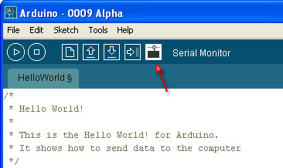
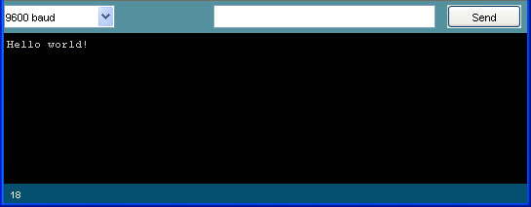
Open the Serial Monitor and Upload the Program
CSE423@DIU, Summer 2019

Slide 31
Some Commands
Serial.begin()
- e.g., Serial.begin(9600)
Serial.print() or Serial.println()
- e.g., Serial.print(value)
Serial.read()
Serial.available()
Serial.write()
Serial.parseInt()
Example Program
CSE423@DIU, Summer 2019

Slide 32
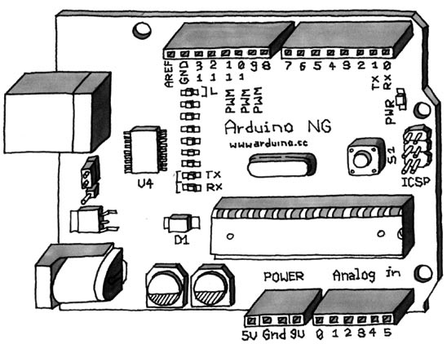
Serial-to-USB chip---what does it do?
The LilyPad and Fio Arduino require an external USB to TTY connector, such as an FTDI “cable”.
In the Arduino Leonardo a single microcontroller runs the Arduino programs and handles the USB connection.
CSE423@DIU, Summer 2019

Slide 33
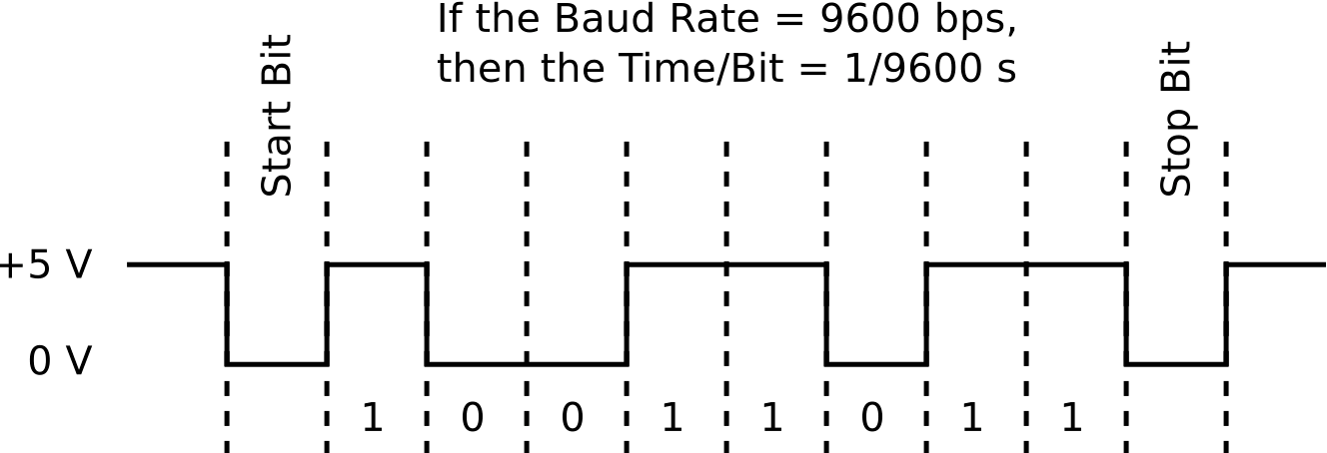
Two different communication protocols
Serial (TTL):
CSE423@DIU, Summer 2019

Slide 34
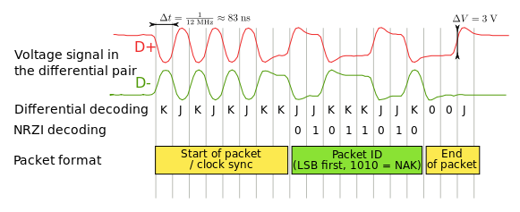
USB Protocol
Image from http://en.wikipedia.org/wiki/USB
Much more complicated
CSE423@DIU, Summer 2019

